Slide 1

Currency Converter
Being Presented By :- Prateek Tripathi

Slide 2
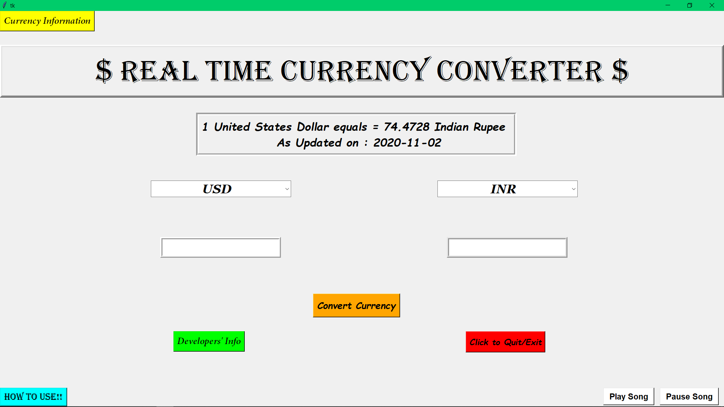
Preview:->

Slide 3
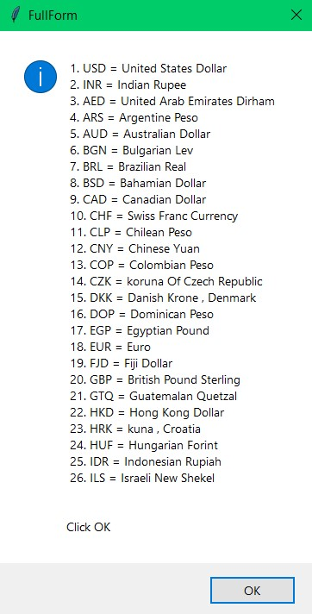
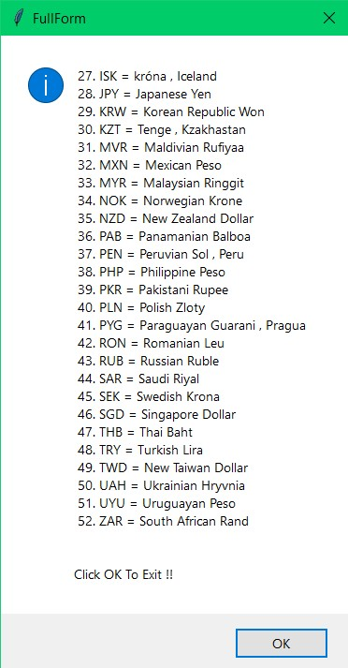
Currency List
+
Details of Currency

Slide 4
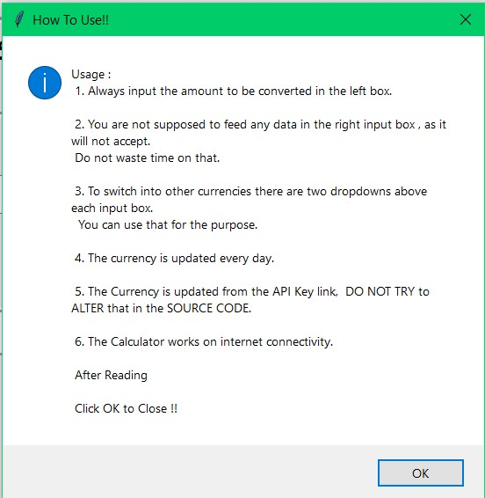
How To Use! Button aka Usage Instructions

Slide 5
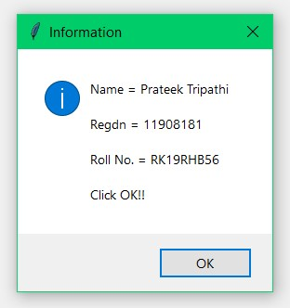
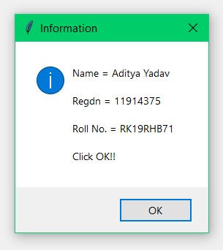
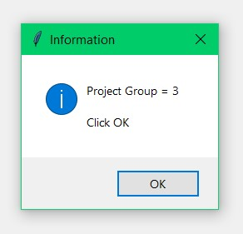
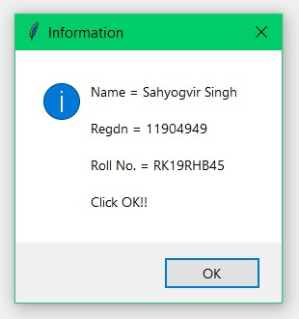
Developer’s Info Button aka Details

Slide 6
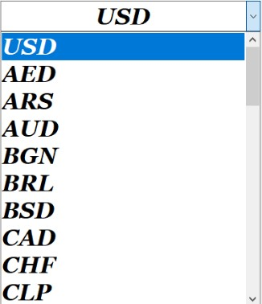
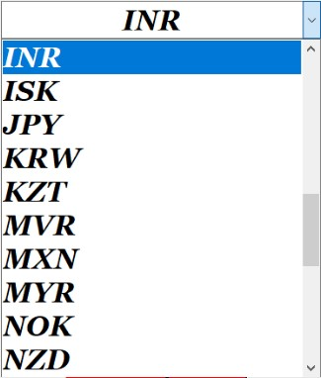
Currency Drop Down List aka Selecting Currency for Conversion
From
To

Slide 7
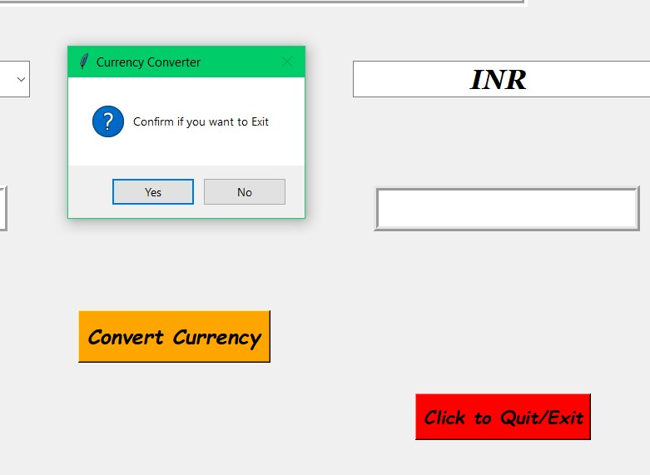
Quit Button aka Exiting The Calculator
Clicking On the RED Button

Slide 8
GitHub Info
https://github.com/er-prateek-tripathi/Currency-Converter

Slide 9
Thank You!!!

